Slide 1

Transitioning from Waterfall to Scrum-Agile
A strategic evaluation of the SNHU Travel pilot project and a case for organization-wide Agile adoption. Presenter: Carlos Castellanos | Scrum Master

Slide 2






Core Roles on a Scrum-Agile Team
Product Owner
Scrum Master
Developers & QA
Value Maximizer: Acts as the sole customer liaison. Owns, orders, and refines the Product Backlog, ensuring high-priority user stories enter development seamlessly.
Servant-Leader: Facilitates Scrum events, shields the team from external scope creep, removes technical blockers, and enforces Agile practices.
Cross-Functional Unit: Self-organizing group holding collective ownership over building and testing shippable increments that meet the Definition of Done.

Slide 3

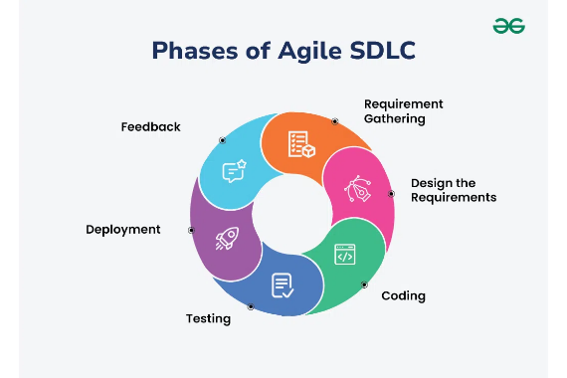
Agile SDLC: Iterative Value Delivery
Continuous Planning & Grooming: Requirements are continuously refined as user stories rather than frozen upfront.
Sprint Execution: Compact 2-week development windows compress design, coding, and testing into parallel tasks.
Embedded Quality Assurance: Testers validate acceptance criteria alongside developers throughout each sprint.
Demonstrable Release: Every sprint produces a functional, defect-free software increment evaluated during Sprint Reviews.

Slide 4
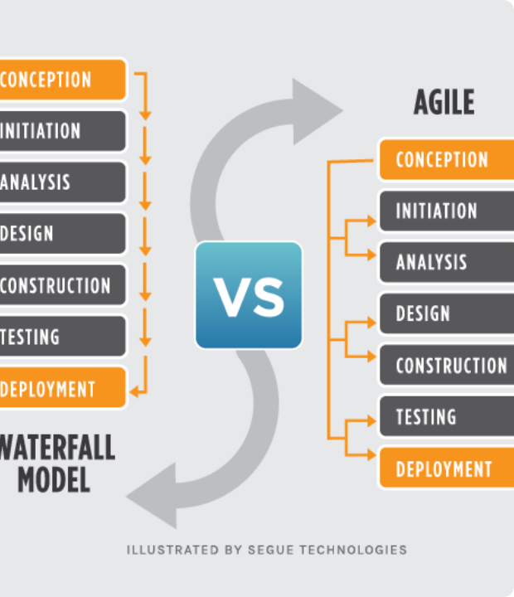
Contrast: Waterfall vs. Agile
Structured Phases vs. Continuous Value
Waterfall Approach: Relies on linear, sequential execution. Requirements are locked early, deferring integration and testing until late in the lifecycle, resulting in high risk and deferred discovery of bugs.
Agile Approach: Breaks releases into short, iterative sprints. Features are continuously designed, implemented, and verified, exposing risk early and enabling rapid feedback loops.

Slide 5


Scenario Analysis: Handling Development Pivots
Waterfall Impact
Agile Solution
When SNHU Travel requested layout changes and updated destination image resource handling mid-project, a Waterfall model would have caused significant disruption:
Under Scrum, the team absorbed changing requirements smoothly within short sprint cycles:
• Emergency changes were routed to the Product Owner for backlog refinement. • Path impediments were identified and resolved during Daily Stand-ups. • Image packaging issues were tested and fixed within the active sprint.
• Required formal change requests and budget approvals. • Delayed release schedules to rewrite static architecture. • Led to late-stage path bugs and missing image errors during final deployment.

Slide 6
Decision Matrix: Waterfall or Agile?
Scope Stability
Client Involvement
Risk & Feedback
Waterfall: Best for fixed, well-understood requirements. Agile: Essential when requirements evolve based on market and client feedback.
Waterfall: Stakeholders interact mainly at project start and finish. Agile: Demands active, ongoing Product Owner and stakeholder collaboration.
Waterfall: High risk of late-stage defect discovery. Agile: Mitigates risk via 2-week feedback loops and early shippable code.

Slide 7
Academic & Professional References
Atlassian. (2023). Agile vs. Waterfall: Choose the right methodology. Atlassian Software Guide. https://www.atlassian.com/agile/project-management/agile-vs-waterfall
Cobb, C. G. (2021). The project manager's guide to mastering Agile (2nd ed.). John Wiley & Sons.
Highsmith, J., Luu, L., & Robinson, D. (2021). EDGE: Leadership strategies for building agility across your business. Addison-Wesley Professional.
Project Management Institute. (2021). A guide to the project management body of knowledge (PMBOK guide) (7th ed.). Project Management Institute.
Schwaber, K., & Sutherland, J. (2020). The Scrum guide: The definitive guide to Scrum: The rules of the game. Scrum.org. https://scrumguides.org/scrum-guide.html

Slide 8



Image Sources
https://media.geeksforgeeks.org/wp-content/uploads/20240612173423/Phases-of-Agile-SDLC.webp
Source: www.geeksforgeeks.org
https://www.seguetech.com/wp-content/uploads/2013/07/segue-blog-waterfall-vs-agile-which-is-right-development-methodology-for-your-project.png
Source: www.seguetech.com

